Slide 1
Voluntary Benefits.
Enrollment Solutions.
Protecting What’s Important
Financial Model Primer
Denny Lyons

Slide 2
Financial Model Primer Agenda
Financial Model Overview
Inputs
5 Year P&L
Real Case Review: Results compared to modeler
Key consulting considerations when completing a financial model

Slide 3
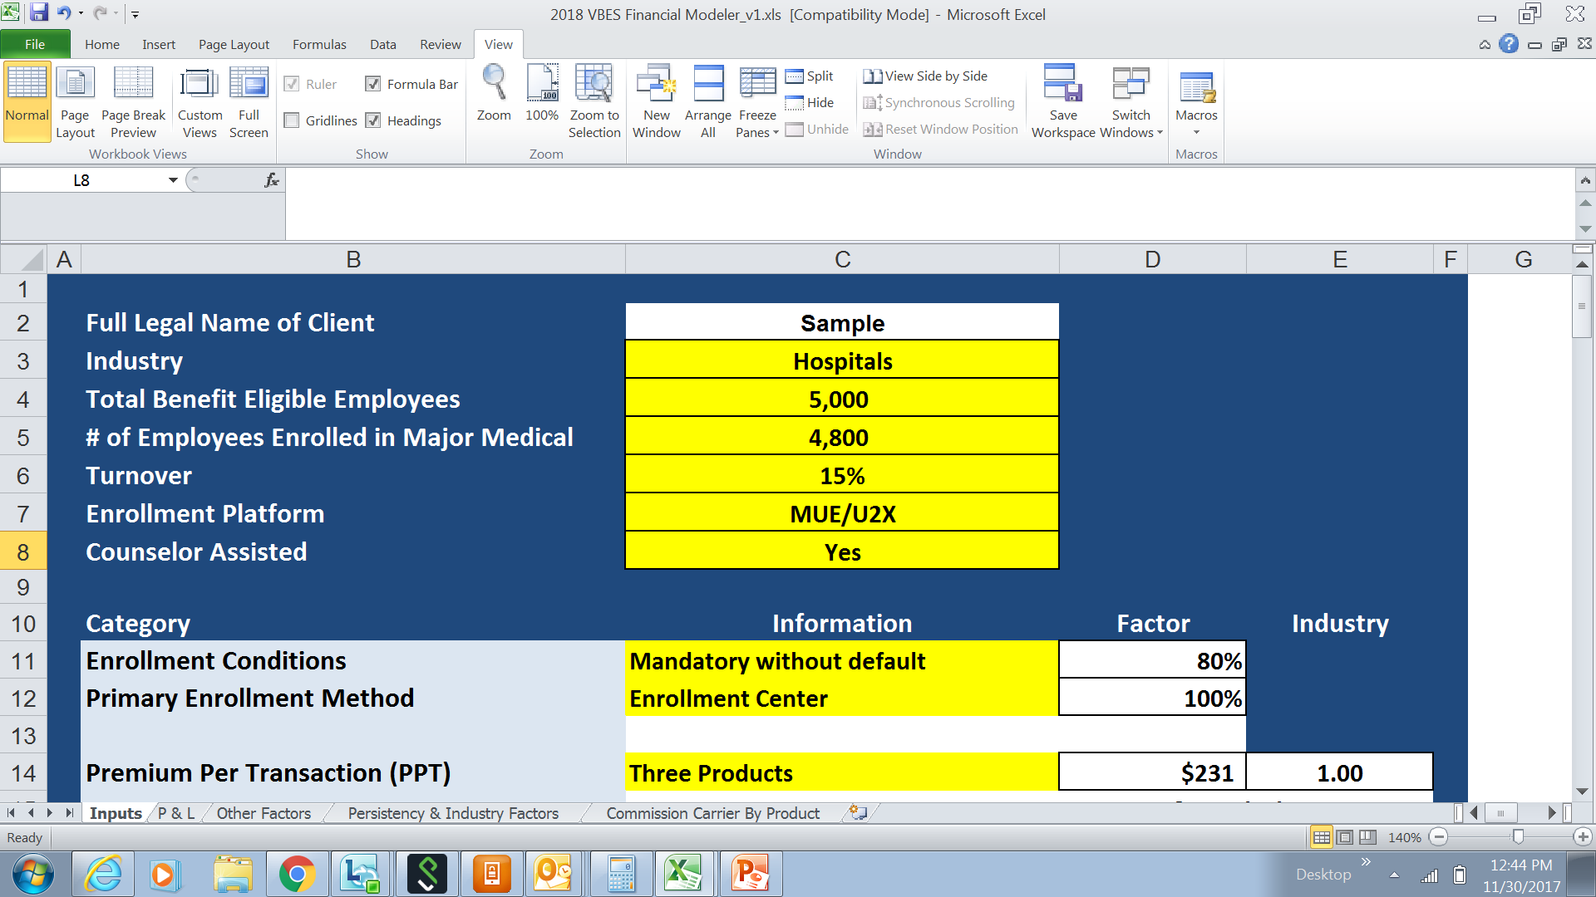
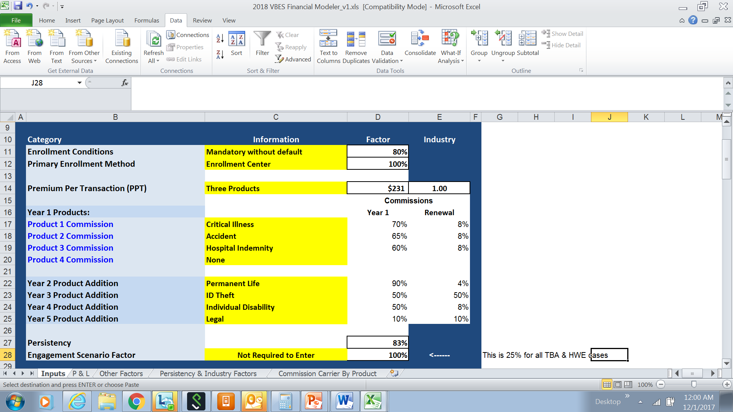
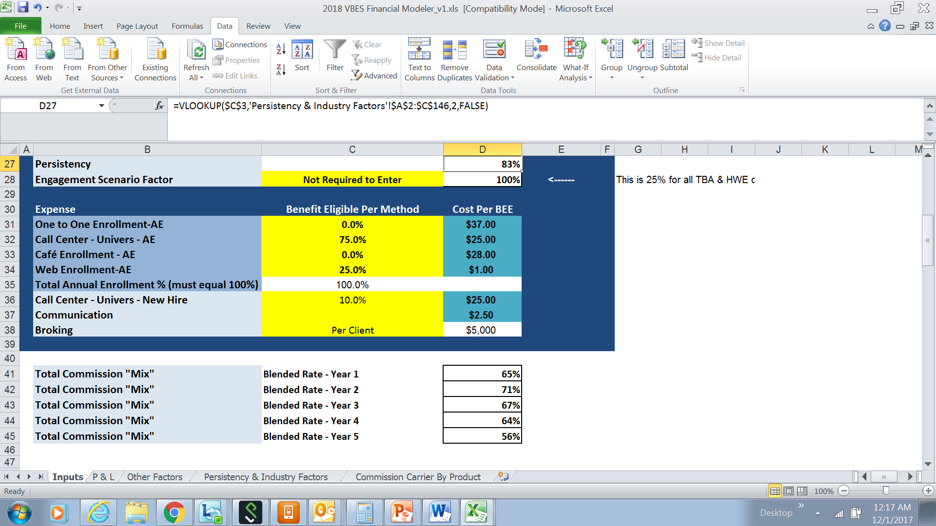
Inputs

Slide 4
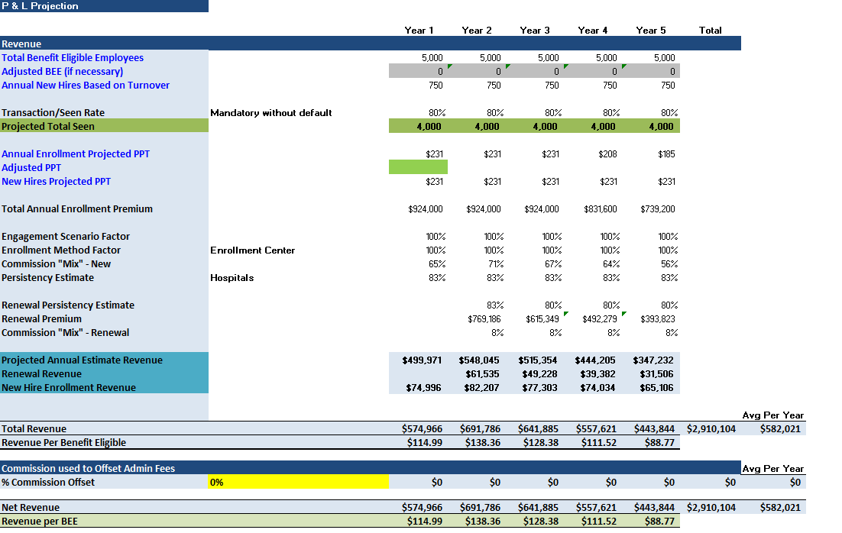
P&L

Slide 5
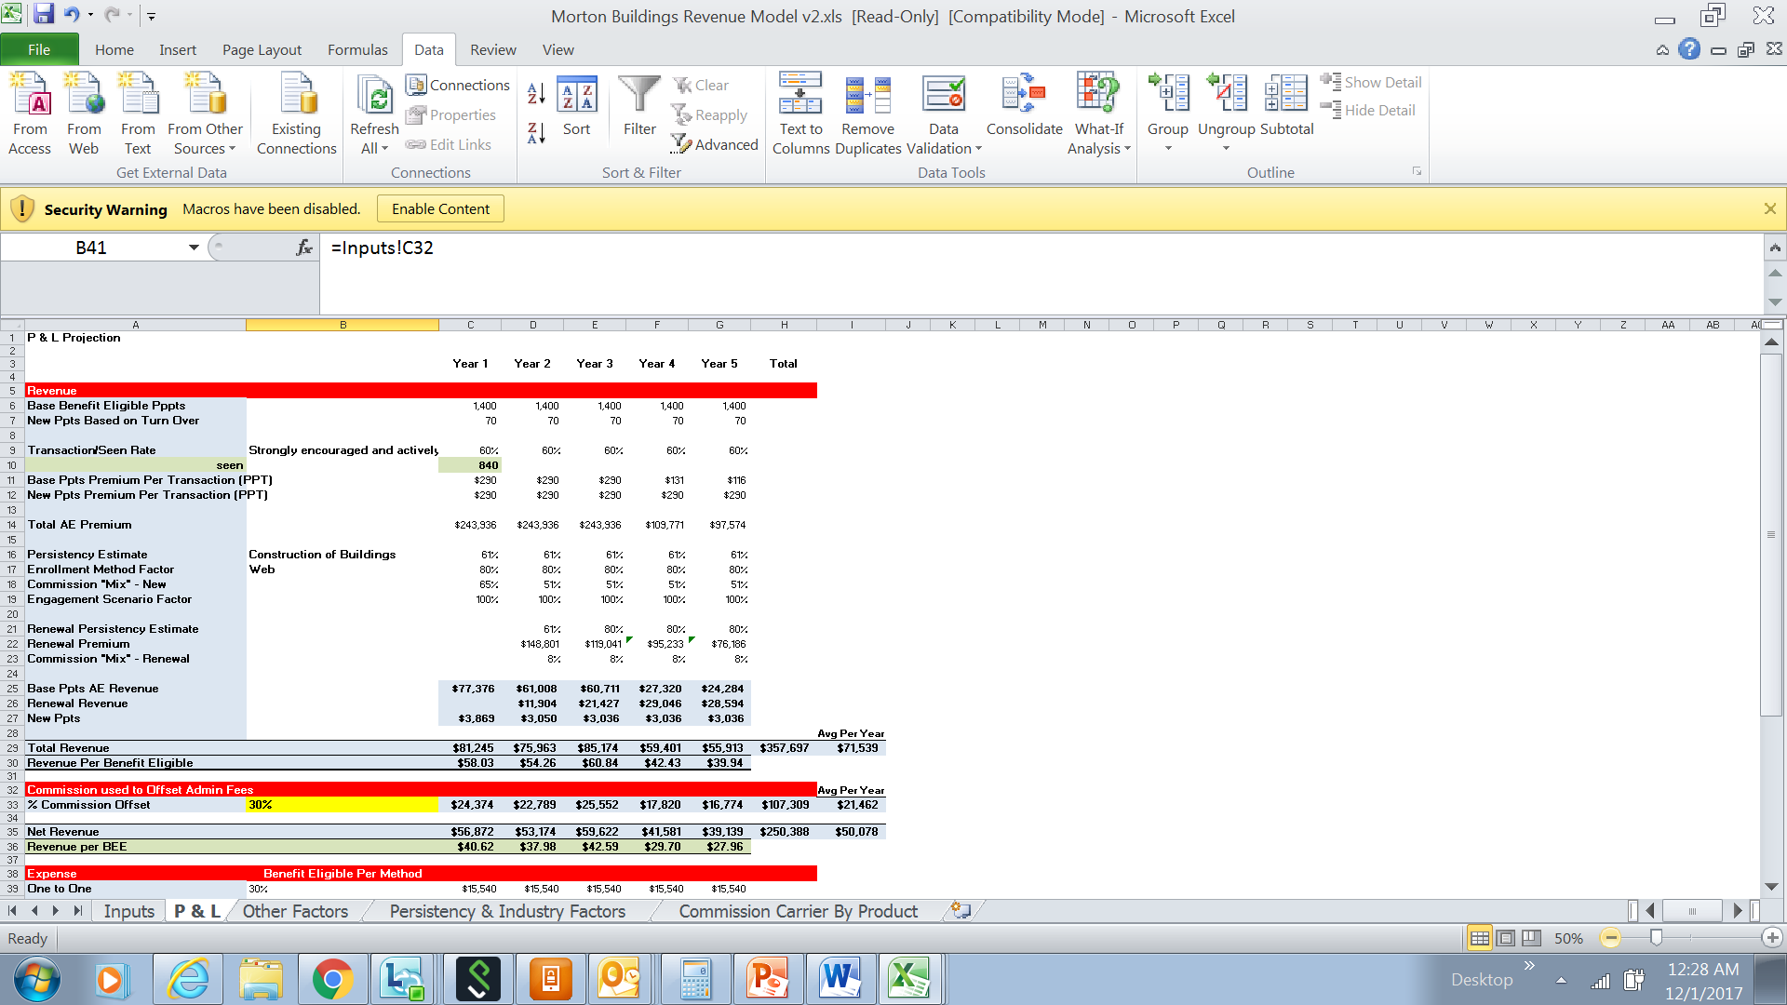
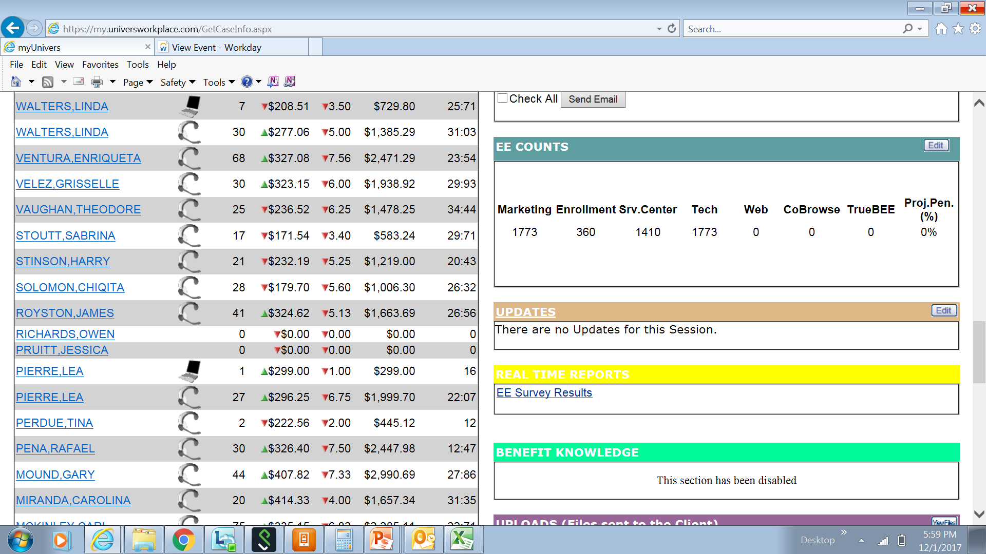
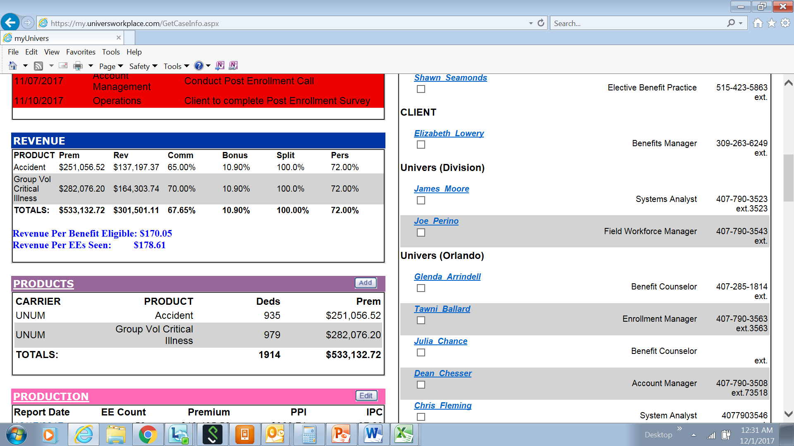
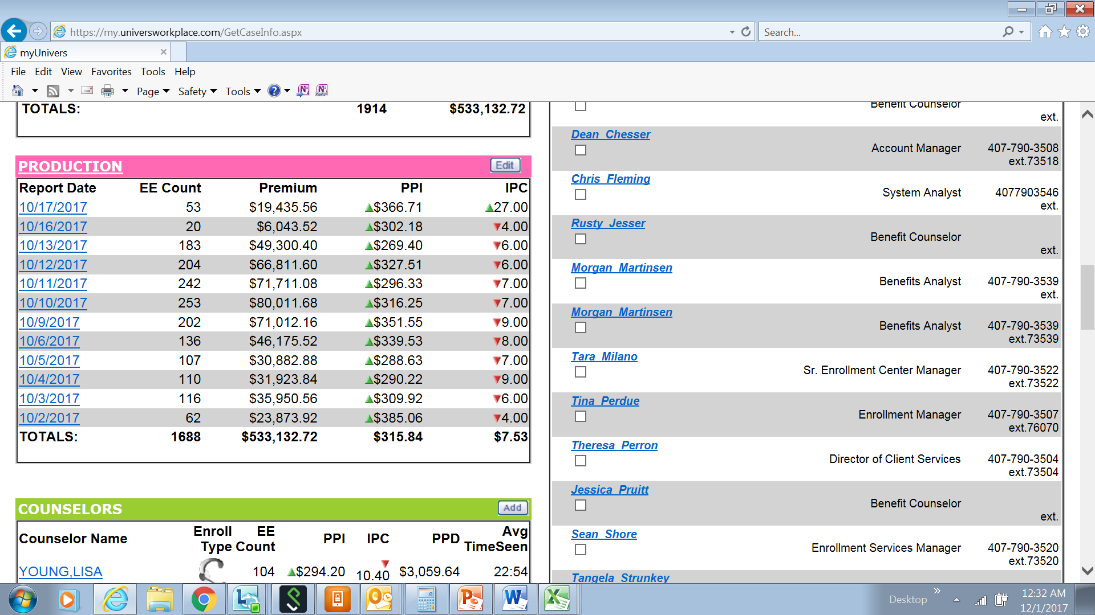
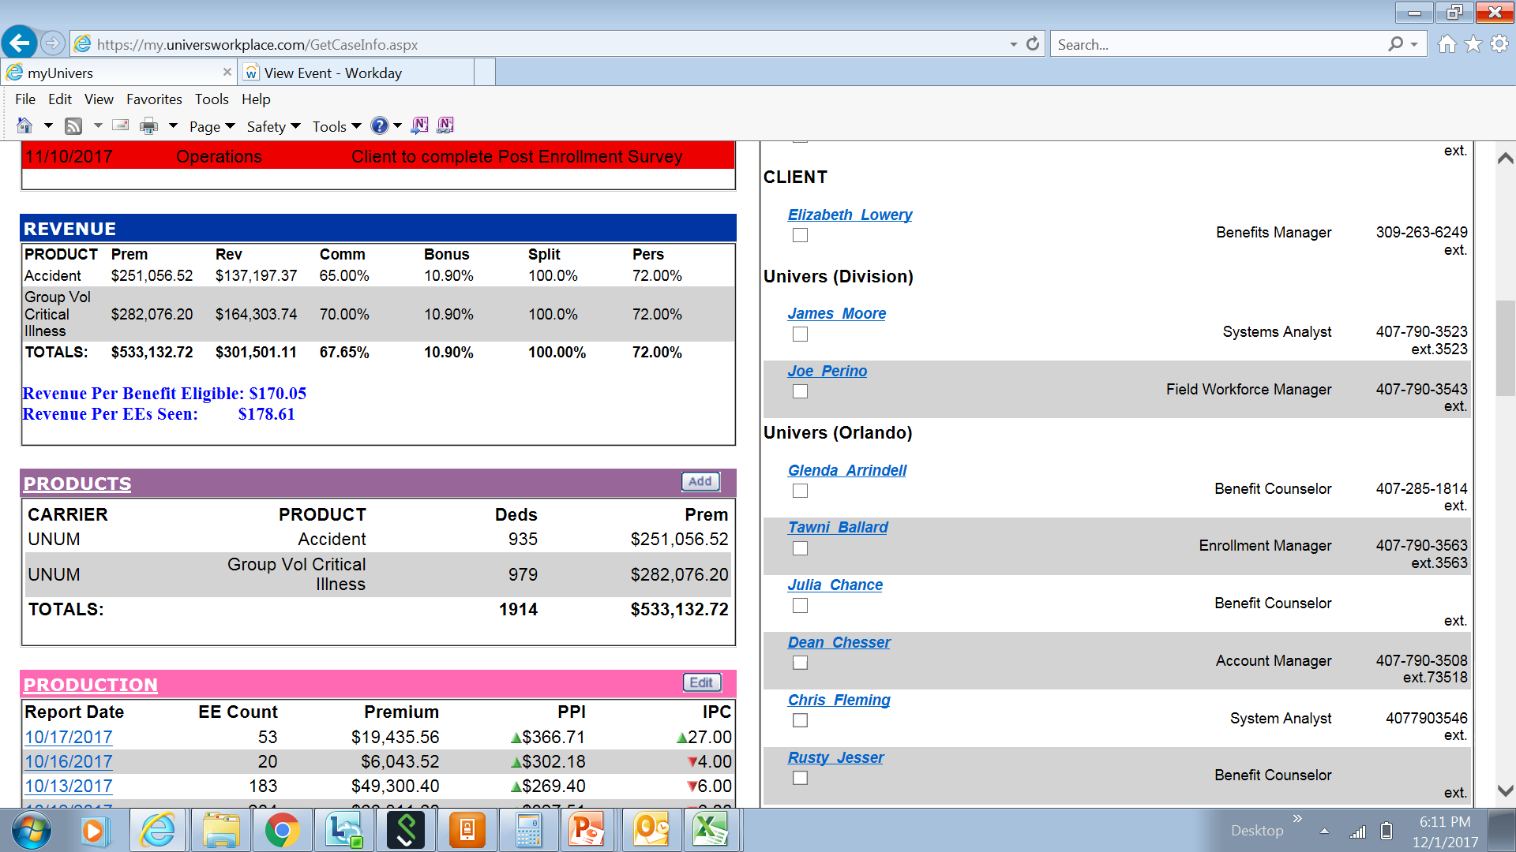
Comparing Morton Buildings Financial Model versus Actual Results
Take Rate
55%
58%

Slide 6
Comparing Morton Buildings Financial Model versus Actual Results
1400
Benefit Eligible Employees
1773
Take Rate
55%
58%

Slide 7
Comparing Morton Buildings Financial Model versus Actual Results
Employees Seen
840
1688
Take Rate
55%
58%

Slide 8
Comparing Morton Buildings Financial Model versus Actual Results
Premium Per Transaction (PPT)
$290
$315.84
Take Rate
55%
58%

Slide 9
Comparing Morton Buildings Financial Model versus Actual Results
Total Premium
$243,936
$533,132.72
Take Rate
55%
58%

Slide 10
Comparing Morton Buildings Financial Model versus Actual Results
$301,501.11
$81,245
Total Revenue
Take Rate
55%
58%

Slide 11
Comparing Morton Buildings Financial Model versus Actual Results
$178.61
$58.03
Revenue Per BEE
Take Rate
55%
58%

Slide 12
Comparing Results Summary – Morton Builders
 | Financial Model | Actual Results
Benefit Eligible Employees | 1,400 | 1,773
Employees Seen | 840 | 1,688
Premium Per Interview | $290 | $315.84
Total Premium | $243,936 | $533,132
Total Revenue | $81,245 | $301,501
Revenue Per BEE | $58.03 | $178.61

Slide 13
Key Consulting Considerations
Accuracy is important!
Key inputs needed
Industry
# of BEE
# of EE’s on medical
Turnover
Enrollment Conditions
Enrollment Methods (One to Once, Enrollment Center, Café, Web)
Enrollment Platform (CBA, TBA, MUE/U2X, MMW, Third Party)
Products

Slide 14
Voluntary Benefits.
Enrollment Solutions.
Protecting What’s Important
Financial Model & Strategic Account Review
(part 2)
Breakout Groups

Slide 15
Financial Model – Input Review

Slide 16
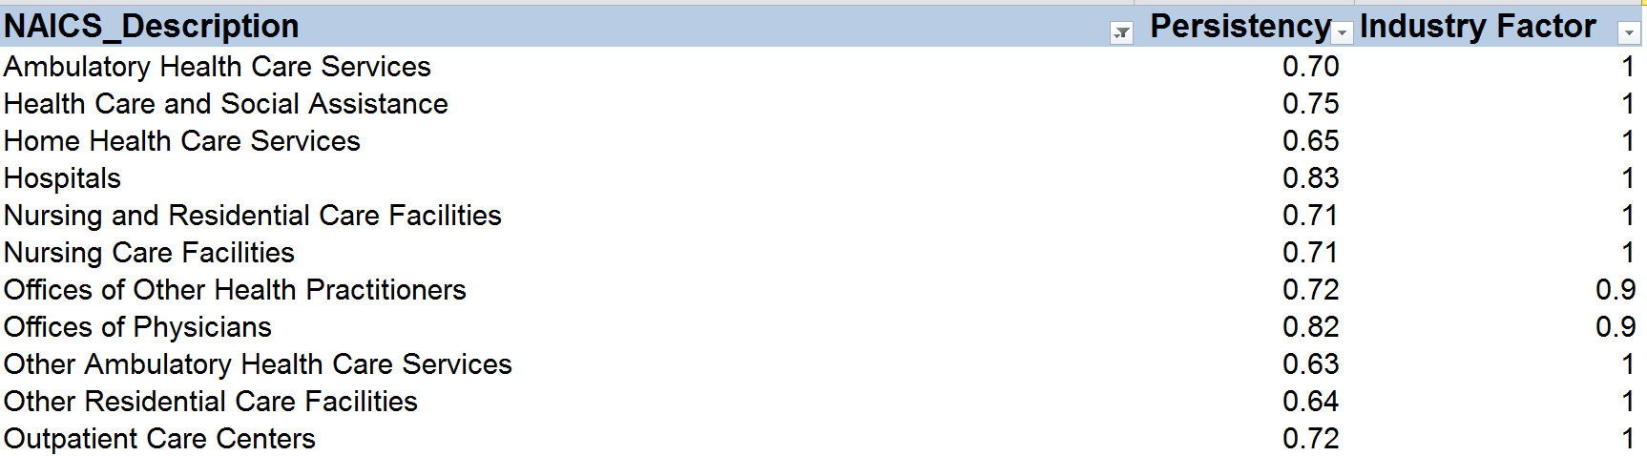
Financial Model – Industry

Slide 17
Financial Model – Benefit Eligible Employees

Slide 18
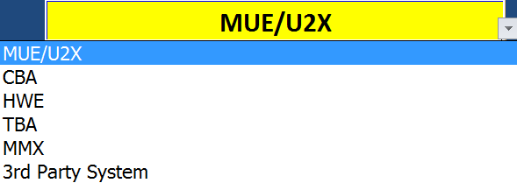
Financial Model – Input Review

Slide 19
Financial Model – Enrollment Method

Slide 20
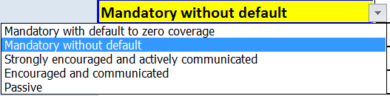
Financial Model – Enrollment Method

Slide 21

Financial Model – Enrollment Method

Slide 22
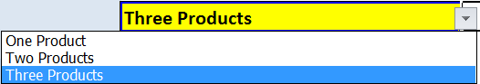
Financial Model – Enrollment Method

Slide 23
Financial Model – Voluntary Products

Slide 24
Financial Model – Voluntary Products

Slide 25
Financial Model – Engagement Scenario Factor
This is 25% for all TBA & HWE cases

Slide 26
Financial Model – Expense Input

Slide 27
Financial Model – Blended Commission Rates

Slide 28
A Cautionary Tale

Slide 29
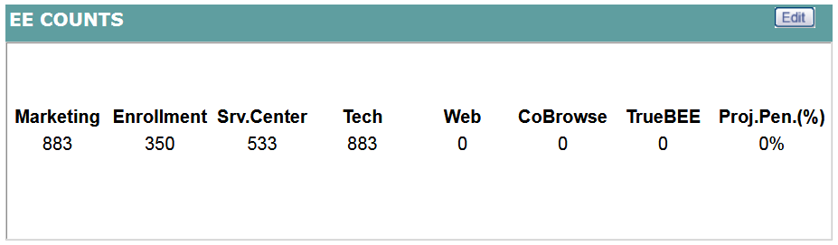
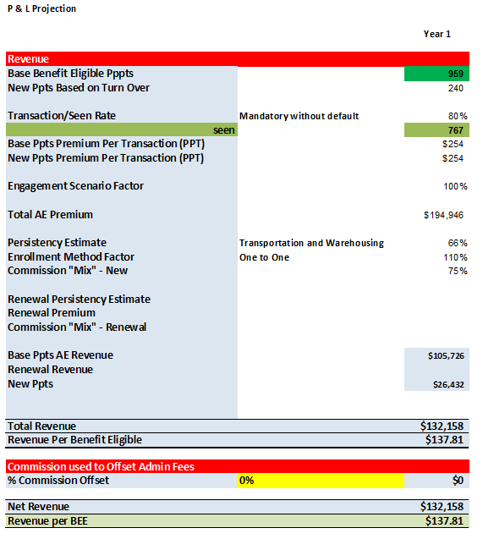
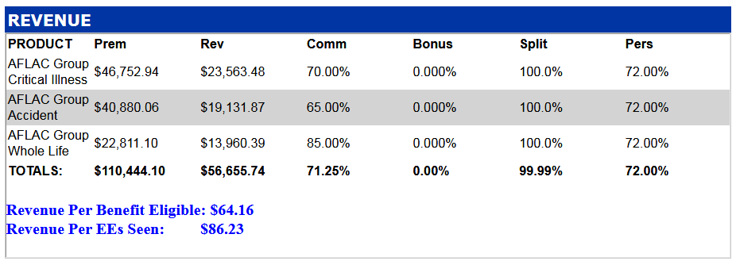
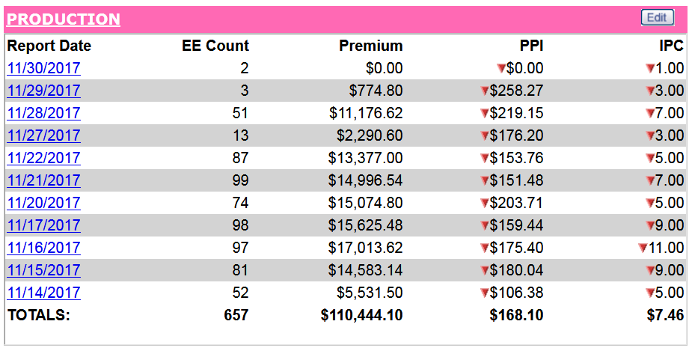
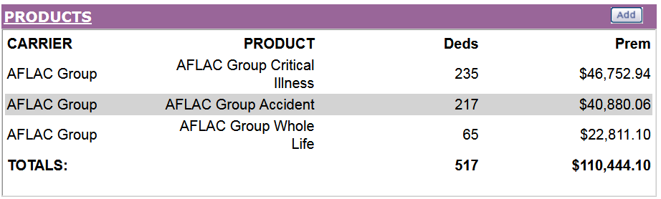
Comparing St George Logistics Financial Model versus Actual Results

Slide 30
Comparing St George Logistics Financial Model versus Actual Results
Benefit Eligible Employees
959
883

Slide 31
Comparing St George Logistics Financial Model versus Actual Results
Employees Seen
767
657

Slide 32
Comparing St George Logistics Financial Model versus Actual Results
Premium Per Transaction
$254
$168.10

Slide 33
Comparing St George Logistics Financial Model versus Actual Results
Total Premium
$194,946
$110,444

Slide 34
Comparing St George Logistics Financial Model versus Actual Results
$56,655.74
Total Revenue
$132,158

Slide 35
Comparing St George Logistics Financial Model versus Actual Results
$64.16
Revenue Per BEE
$137.81

Slide 36
Comparing Results Summary – St George Logistics
 | Financial Model | Actual Results
Benefit Eligible Employees | 959 | 883
Employees Seen | 767 | 657
Premium Per Interview | $254 | $168.10
Total Premium | $194,946 | $110,444
Total Revenue | $132,158 | $56,665
Revenue Per BEE | $137.81 | $64.16

Slide 37
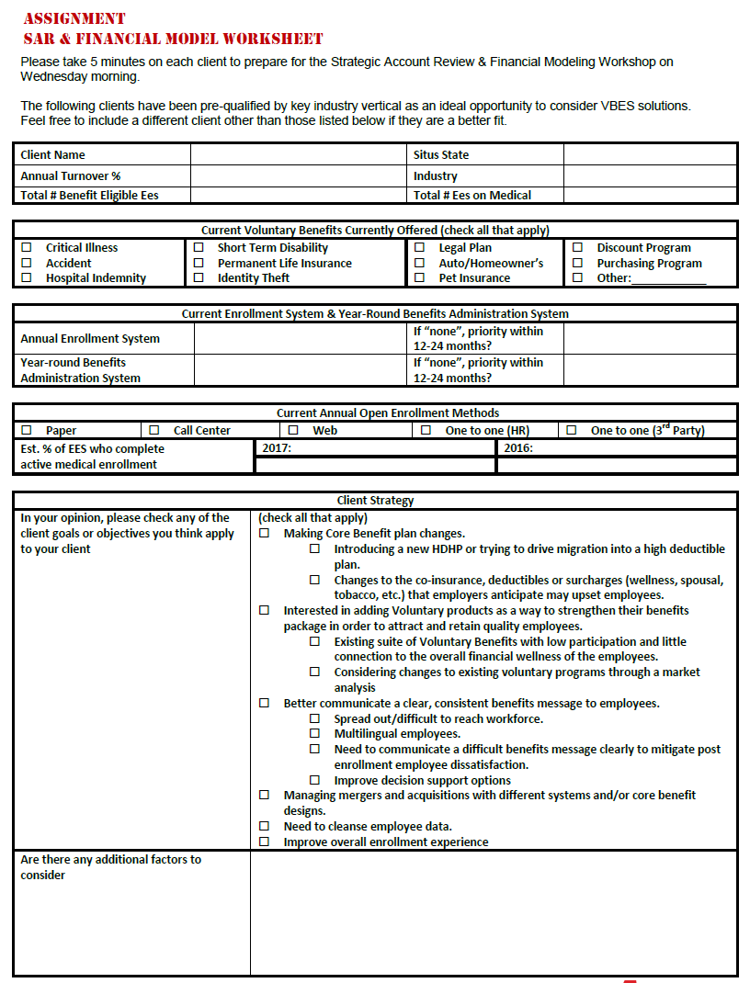
Financial Model Exercise - Case 1
Product Strategy
Enrollment Strategy
Total Revenue
Average Commission Mix
Other Specific Considerations
Notes:
*Reminder: Regarding offset commissions, always check with compliance and legal to be sure!

Slide 38
Next Steps
Partner with your local VBES consultant to discuss next steps
Work with VBES consultant to complete financial model for 2nd client
Schedule client facing meeting(s) to review strategy
Work within your local market and with your VBES consultant to identify additional opportunities

